Slide 1
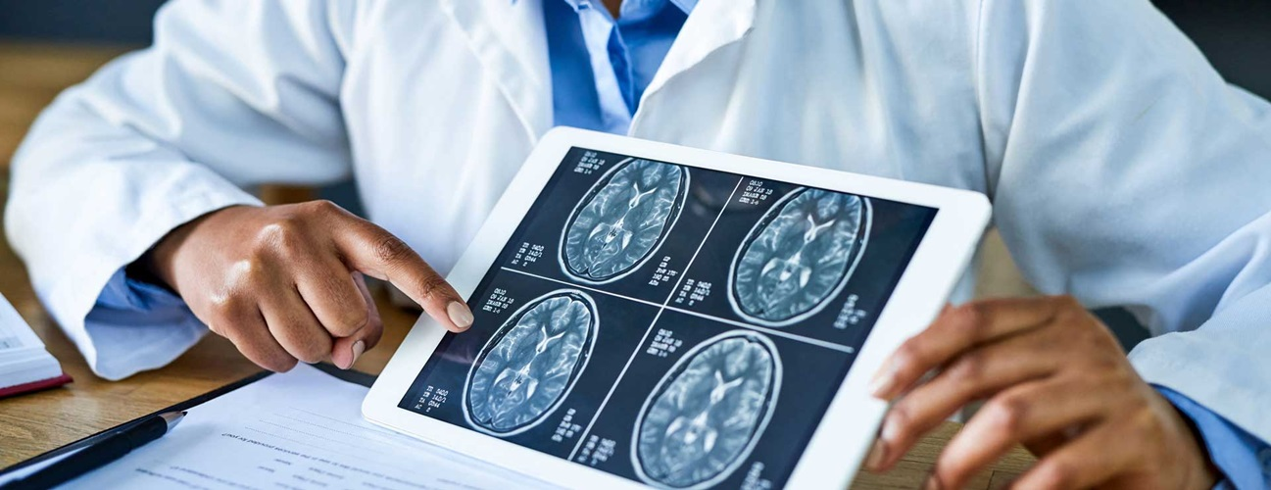
Brain Tumor Classifier
Jade Tran
Notes:
Image source: https://www.independent.co.uk/life-style/health-and-families/brain-tumour-missed-doctors-wales-b2171899.html

Slide 2
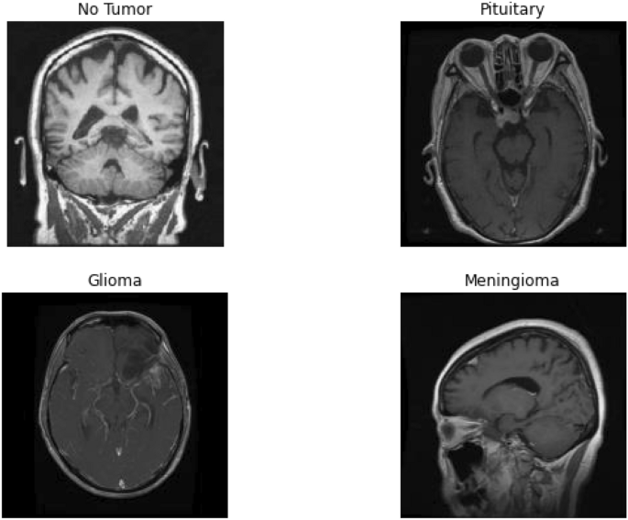
Non-technical overview
Problem Statement
1 million of American are living with brain tumors
Survival rate (malignant ones): 35.7%
Best technique: Magnetic Resonance Imaging (MRI). Radiologists + professional neurosurgeon is required.
Notes:
Best technique to detect brain tumors is Magnetic Resonance Imaging (MRI), These images are examined by radiologists and professional neurosurgeons, hence, an automated system such as this classifier can add a valuable opinion in a timely manner
Estimated potential impact:
The more images are fed into the machine, the better the performance will be
Early detection and diagnosis
Reduced human errors, although this machine learning model is not deem to replace human, having a second opinion in a timely manner is always better than late diagnosis
Speed up workflow efficiency
Assist doctor to make accurate diagnosis and treatment plants
Proposed solution:

Slide 3
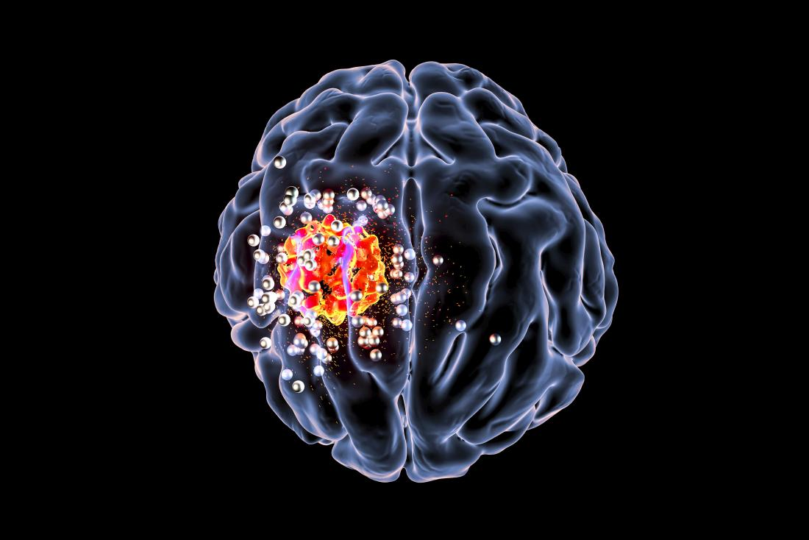
Preprocessing Procedures
Download Kaggle dataset: Brain Tumor Classification & MRI Image Dataset
Finding duplicates from 2 datasets using DifPy package
Convert images into Tensor
Make sure they are all in equal sizes and attach labels for them
Shuffle the dataset
Randomize the order they are presented
Prevent bias/Increase efficiency
Notes:
Image source: https://www.medicalnewstoday.com/articles/321809
Kaggle datasets containing 4 types of tumors: glioma, meningioma, no tumor and pituitary
Difpy will go through all of the images in a folder and comparing them manual to check if they are duplicates or not
Important findings through EDA:
Overall, there’re roughly 6,300 images after sorting out the duplicates
All images are in different sizes -> resize them
Attach labels since the computers cannot recognized which one is glioma so we’ll number them from 0 to 4

Slide 4
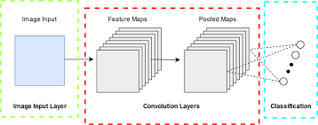
Baseline model & Evaluation Metrics
Baseline mode:
Built with 1 layer of CNN
Split data with 9:1 ratio with 10% of dataset for testing
Epoch is chose randomly: 30
Evaluation: Overall accuracy of 89% across all classes
Tumor | Glioma | Meningioma | No tumor | Pituitary
Accuracy | 92% | 80% | 91% | 91%
Notes:
https://www.researchgate.net/figure/A-single-layer-Convolutional-Neural-Network_fig1_343193916

Slide 5
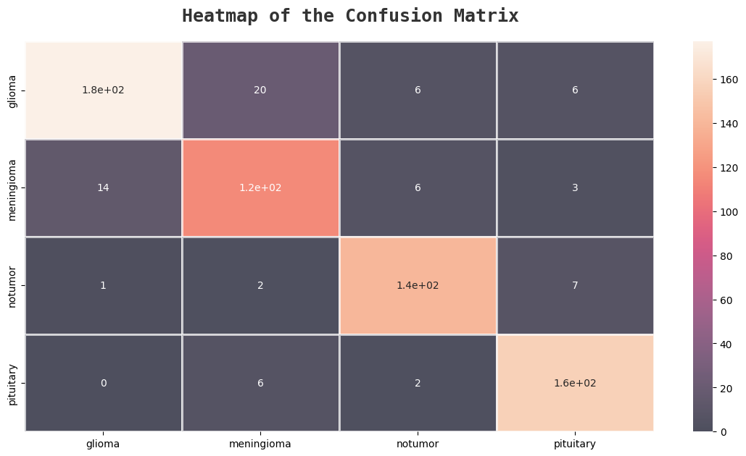

Slide 6
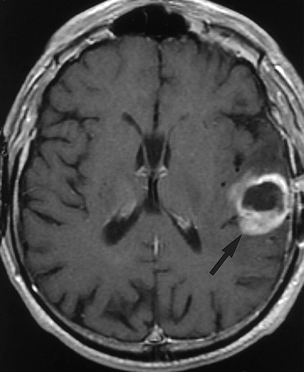
9-layer CNN model and Resnet
More refined network
Epochs: 50 => more training
Avoid randomness
Resnet: CNN architecture that is pre-trained on ImageNet dataset containing 100,000+ images across 200 different classes)
 | Glioma | Meningioma | No tumor | Pituitary
9-layer CNN | 88% | 90% | 97% | 93%
Resnet | 98% | 89% | 96% | 97%
Notes:
Both convolutional neural network architectures used for image classification (Resnet34 is pre-trained on ImageNet dataset containing 100,000+ images across 200 different classes.)

Slide 7

 | Glioma | Meningioma | No Tumor | Pituitary
1-layer CNN | 92% | 80% | 91% | 91%
9-layer CNN | 88% | 90% | 97% | 93%
Resnet34 | 98% | 89% | 96% | 97%
Notes:
When we put all of them together and compare, we can see that with each update, from the basic model to transfer learning, the accuracy has improved significant and the overall accuracy is also dis
Overall, we can see that even when the performance varies across classes, Resner generally achieves the highest accuracy across all classes, indicates its effectiveness in this task.
The 1-layer CNN performs consistently well but not as effective as Resnet
The 9-layer CNN shows mixed results compared to the other models, while it outperforms the 1-layer in some cases (no tumor, or pituitary), it’s still not consistently the best-performing model across all classes
In medical diagnosis task like tumor classification, high accuracy is crucial since we want to minimize misdiagnosis and ensure proper tx for patients so here’re the next few steps we can take to better the performace

Slide 8
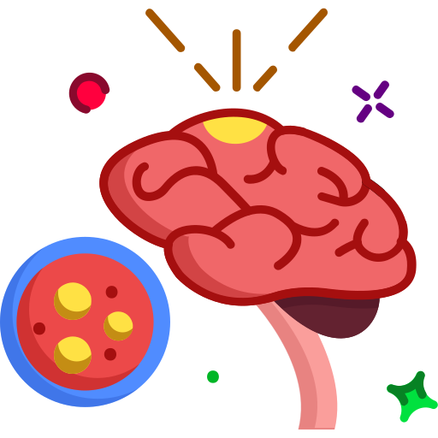
Next steps
Model with 9 layers of CNN
Play with hyperparameter tuning
Change the number of layers
Data augmentation
Finding medical image: challenge + accessibility
Augmentation: reduce overfitting & improve precision
Bonus: create function to try different optimizers, activation functions
Use other pre-trained neural network - Resnet50 or YOLOv8
Notes:
Image source: https://www.flaticon.com/free-icon/brain-cancer_10619776
Why Resnet34, not Resnet50? Both convolutional neural network architectures used for image classification (Resnet34 is pre-trained on ImageNet dataset containing 100,000+ images across 200 different classes). 34 has 34 layers, 50 has 50 layers (one is shallow than the other -> 50-layer network can capture more nuances and learn more intricate features)
resnet50 : more complex, but computationally demanding compared to resnet34. Our case, the data is not quite big, Resnet34 should provide enough efficiency
YOLOv8 (You Only Look Once): newest architecture that is famous for its considerable accuracy in the field of object detection, instance segmentation and classification (https://blog.roboflow.com/whats-new-in-yolov8/)

Slide 9

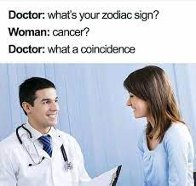
Notes:
Image source (1st):
https://www.reddit.com/r/memes/comments/qbbwup/deadly_coincidence/
Image source (2nd) : https://imgflip.com/i/6tfhr5

